Slide 1
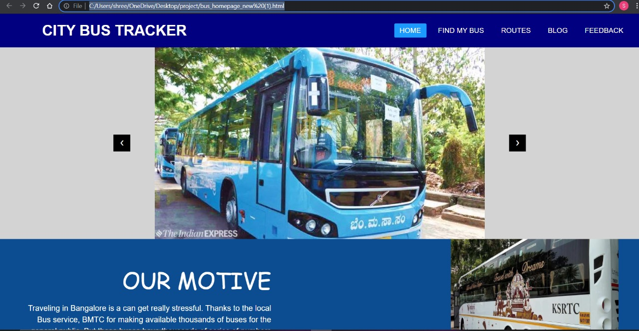
Pitch Deck!
Team members:
Pragathi Y P , Shreehari , Prem and Shivam.
Mentor:
Nevasini

Slide 2
Introduction
Problem Statement:
We have seen that the main issue in switching over to public transport is not knowing the routes of the buses as majority board are in Kannada only. We cannot keep a track of the innumerable buses and their respective routes which are deployed across the city .
2.Your Solution:
Our website expects the user to just enter the bus number that he or she wants to take and provides accurate and efficient information regarding the origin and the destination of that bus .
The user can also input the destination and the website will display the bus number that has to be taken in order to reach the destination punctually.

Slide 3
3.Implementation:
The user can enter the bus number and find the orgin and destination of the input bus number. The website also contains an attractive homepage that allows the user to give their feedback and also users can view the about section of the webpage.
Though the website is under development, we aim to improve by integrating google maps such that the route is mapped by entering only the bus number as well as notify the user when they near their destination and provide all the necessary information like cost and timings and make it highly convenient for the passengers. We also intend to provide all possible routes and buses that can be taken from a source to the destination.

Slide 4
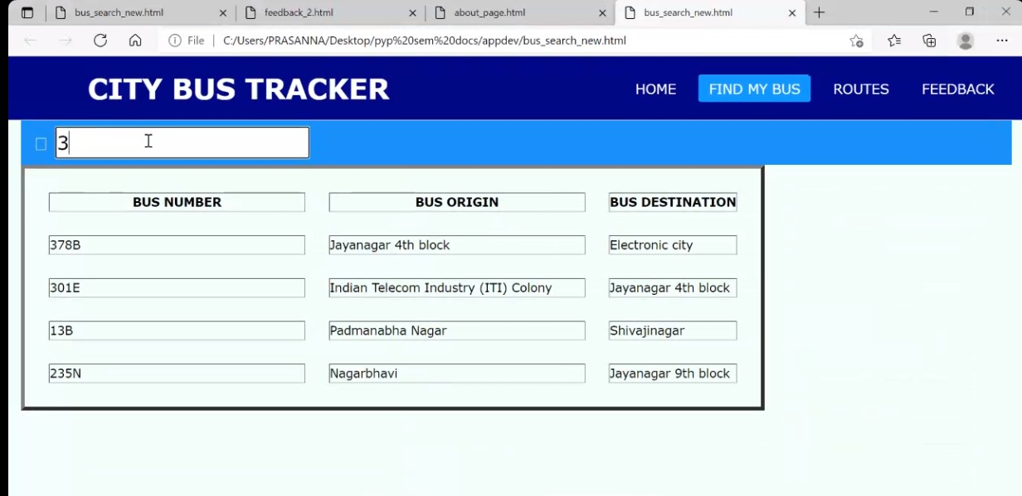
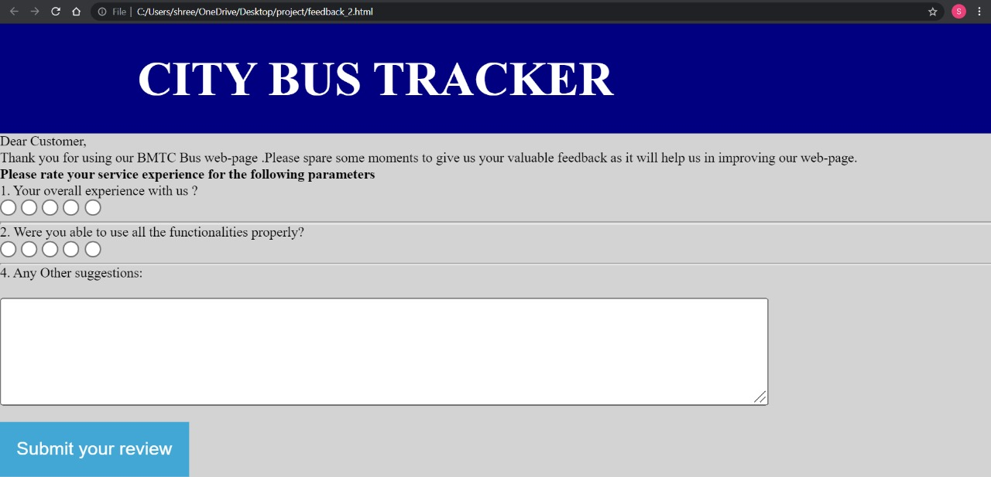

Slide 5
Tech Side
Software Stack and Resources that we used:
We created the attractive interface using html and css whereas javascript was used for the functionalies of the website. We also used python to find all the bus routes possible from a source to destination using a path finder algorithm , though it had a few glitches , we hope to improve it and make it efficient in the near future.
2. Individual contributions of the team members:
Pragathi Y P: The homepage , about section and the webpage that is used to enter the bus number to find information regarding it.
Shreehari: Feedback form , path finder algorithm for finding all possible bus routes which has a few glitches that he intends to resolve in the future.

Slide 6
Money Part
We would like to develop our product in the future which will require us to gain knowledge of additional tech like database management softwares like MySql, Figma for a better UI , Selenium web driver and Python along with a built-in library Beautiful Soup for web scraping .
We would require a considerable amount of money to get the legal licenses of some software and Apis for navigation and deployment of the website.
Yes , we would like to generate revenue out of our product by allowing Google addsense on our website . We would also like to develop direct bus ticket booking and charge the customers for the service rendered.
How pumped are you to start a company ( LOW, MEDIUM, HIGHHH)?
Medium.

Slide 7
Showcase Area
Showcase your demo (Could be a wireframe, or an app or a live demo)
Link to the Medium Blog or Github repo here.
What’s left to complete the entire thing (Need not type this point, just present to us)
what worked, what did not work and do you know why ( Optional or keep it short).

